Slide 1
CPSC3300: Computer Systems Organization
Lecture 8 – Counters and Finite State Machines

Slide 2
Administrivia
Exam 1
Online via Canvas
Exam is open-notes
Thursday February 11
Sample questions will be available on Canvas

Slide 3
Overview
A sequential device: counters
Finite state machines

Slide 4
Sequential logic implementation
Models for representing sequential circuits
finite-state machines (Moore and Mealy)
representation of memory (states)
changes in state (transitions)
Basic sequential device
counters

Slide 5
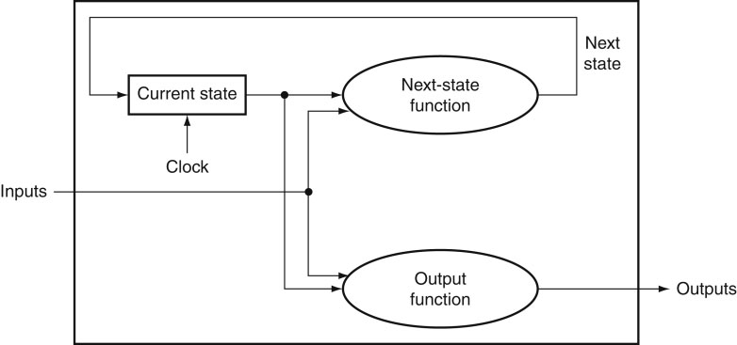
State Machine Model
States: S1, S2, ..., Sk
Inputs: I1, I2, ..., Im
Outputs: O1, O2, ..., On
Transition function: Fs(Si, Ij)
Output function: Fo(Si) or Fo(Si, Ij)

Slide 6
FSM design procedure
Describe FSM behavior, e.g. state diagram
Inputs and Outputs
States (symbolic)
State transitions
State diagram to state transition table
Inputs: inputs and current state
Outputs: outputs and next state
Implementation
flip-flop for each state bit
synthesize combinational logic from encoded state table

Slide 7
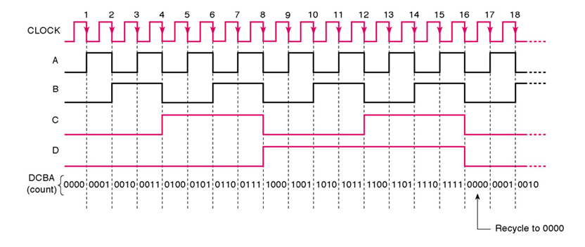
Counters
A0
A1
A2
A3
This counter counts from 0000, 0001, 0010, …, to 1110, 1111, 0000 cycle by cycle and restarts.

Slide 8
Example: Implement a Modulo-4 Synchronous Counter
Using D Flip-Flops
Counts from 0 to 3 and then repeats.
It has a clock input (CLK) and a RESET input.
Outputs appear as a sequence of values (q₁ and q₀) at time steps corresponding to the clock.
As the outputs are generated, a new state (s₁s₀) is generated and fed back to the D flip-flops.

Slide 9
The Mod-4 Counter
Requires four states, encoded in binary, with at least two bits for them to be encoded uniquely.
A = 00
B = 01
C = 10
D = 11
The input requires only a single bit.
0 | 1

Slide 10
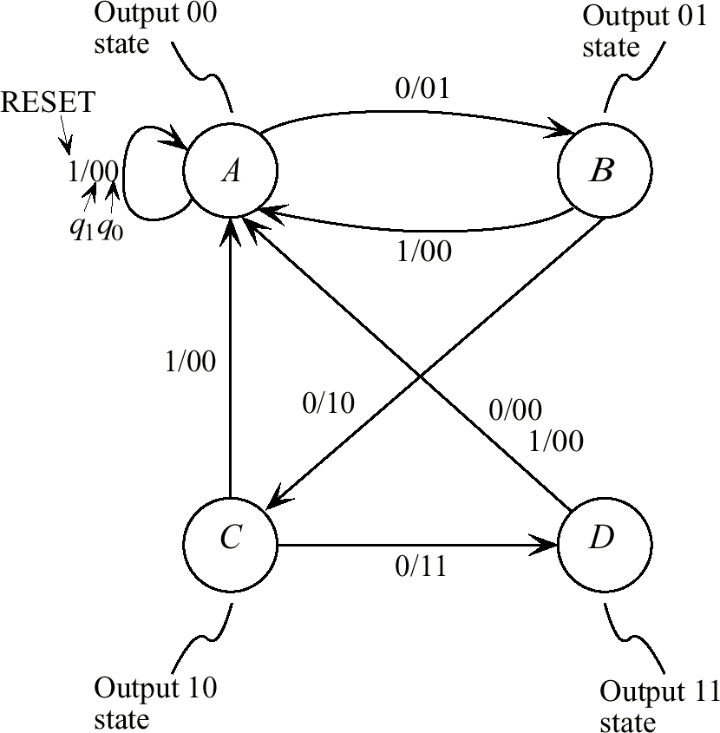
State Transition Diagram for the Mod-4 Counter

Slide 11
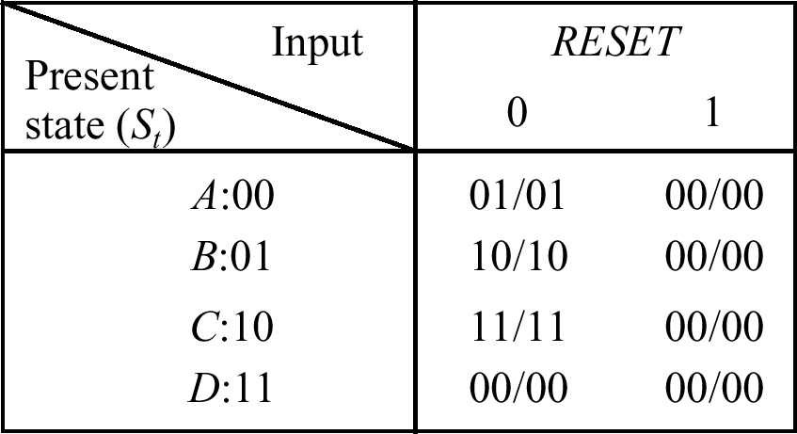
State Encoding and Table
Next state
Output
In this example, output happens to be the same as the next state. They are usually
different for most devices.

Slide 12
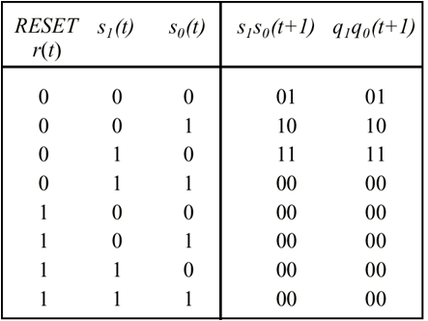
State Table for the Mod-4 Counter

Slide 13
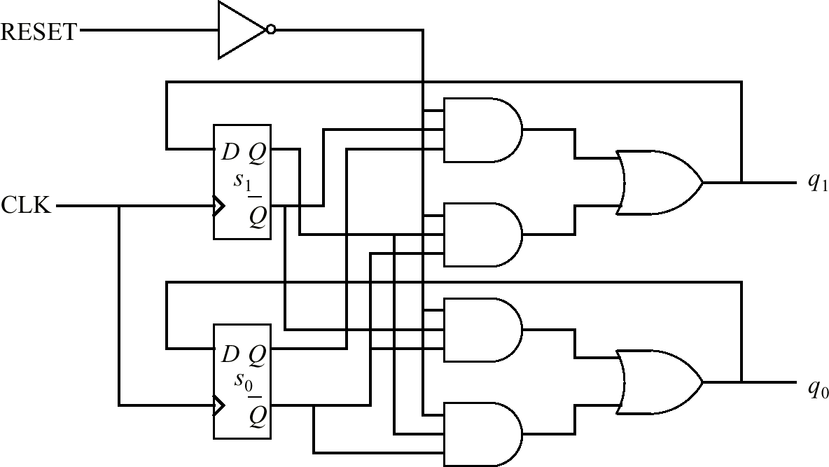
Logic Design for Mod-4 Counter

Slide 14
Summary
Counter
An important device on processors
Finite state machine for sequential circuit
State diagram
State transition table
Circuit design

